Slide 1
2
Develop Your Communications Plan
Master Your Security Incident Response Communications Program

Slide 2
Phase 2: Develop Your Communications Plan
PHASE 1
PHASE 2
1.1
1.10
2.1
2.10
Learn the Basics of Incident Response Communications
Begin Considering Your Message
Create an Internal Communications Plan
Consider Sharing Information With Your Peers
This step will walk you through the following activities: | This step involves the following participants:
Create an internal communications plan. Develop an external communications strategy. Draft the SIRT Policy. Run tabletop exercises. Track metrics. | IT/Cybersecurity leader Legal representative Public relations/communications specialist HR representative
Outcomes of this step
Internal communications plan. Interdepartmental communications template. External communications strategy. SIRT Policy. Sample tabletop exercises. Communications metrics tracking tool.

Slide 3

Phase 2 outline
Call 1-888-670-8889 or email GuidedImplementations@InfoTech.com for more information.
Complete these steps on your own, or call us to complete a guided implementation. A guided implementation is a series of 2-3 advisory calls that help you execute each phase of a project. They are included in most advisory memberships.
Guided Implementation 2: Master Your Security Incident Response Communication Program Proposed Time to Completion: 6-8 weeks
Step 2.1: Create an Internal Communications Plan | Step 2.2-2.10: Develop an External Communications Strategy
Start with an analyst kick-off call: Explore the elements of internal communications and their relationship to external communications. Review the most likely threats for your organization and plan to respond to them. Discuss challenges with internal communications and how to solve them. | Review findings with analyst: Discuss the external communications process, the value of a communications sequence, and how to manage fallout. Understand the role of social media in incident response. Outline how to implement tabletop exercises as part of training. Review elements of a strong SIRT Policy. Learn how to conduct an effective post-mortem review of the incident and how to track metrics.
Then complete these activities… Create an internal communications plan. Decide on an internal communication method. | Then complete these activities… Develop external communications strategy and SIRT Policy. Run tabletop exercises. Track incident response communications metrics.
With these tools & templates: Security Incident Response Interdepartmental Communications Template | With these tools & templates: Security Incident Communications Policy Template Security Incident Communications Guidelines and Templates Tabletop Exercises Package Security Incident Metrics Tool
Phase 1 Results & Insights: Develop both an internal and external communications plan suitable for your organization, based on its culture, politics, and risk tolerance. SIRT Policy. Communications training via simulated incident scenarios and the value of reviewing how the crisis was handled.

Slide 4
Create an internal communications plan
2.1
1. Introduce the SIRT (to each other)
The first step towards developing a good internal communications plan is to have SIRT members get used to interacting with each other so that members understand what issues are seen as important by each department the members come from. Consider using games that focus on teamwork and communication to help them get used to each others’ perspectives (e.g. office scavenger hunt).
2. Survey possible threats (inside and outside)
Using the template provided (step 1.8), develop a threat-escalation chart and assess who needs to be notified for each severity level. These decisions will be unique to each organization, but remember to strike a balance between transparency and need-to-know – especially when it comes to employees. It may be ideal to report all incidents to employees as way to teach them that the organization is not impenetrable and that they have a role to play in the organization’s security, but you shouldn’t overlook the possibility of an insider threat who you may be tipping off by openly communicating.
3. Establish a communication method (and a backup)
Communication is a major responsibility of the SIRT, so it is important that each member can easily contact the others, as well as stakeholders. Standard office communication may work well now, but if an attack knocks out the phone and email systems, you’ll need a backup. A backup communications method doesn’t need to be fancy; it just needs to efficient and reliable – a third-party email client, IM service, or cellular phones are all possible options. However, avoid using social media as a backup: it only takes one wrong click for the whole conversation to become public news.

Slide 5
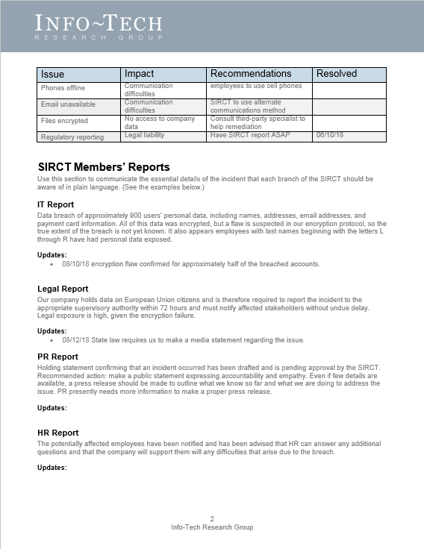
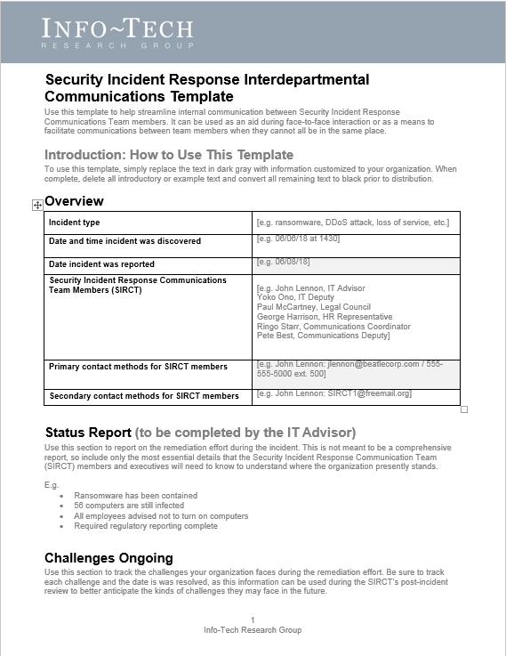
Customize the Security Incident Response Interdepartmental Communications Template
2.1
Security Incident Response Interdepartmental Communications Template
When it comes to communicating the specifics of an incident to all the involved personnel, it’s hard to beat a face-to-face meeting.
However, sometimes this just isn’t possible. Modern organizations are structured in ways that often prevent people from meeting in the same room as often as may be desired.
This doesn’t mean that communication has to stop until the SIRT can meet in person. In fact, there is no one-size-fits-all approach to incident response communications, and some organizations might be comfortable to coordinate these efforts remotely. It really depends on the organization in question and the ways they’re comfortable doing business.
However, even when all SIRT members are in the same place, communication can still be challenging, so it’s a good idea to have a communications record to fall back on, so that each team member can easily recover the information they need when they need it.
Regular communication between SIRT members is important. Use this template to communicate updates to other team members as soon as new information becomes available.
Remember to keep a copy of these exchanges for the post-incident review. They can be a valuable window into how to further improve communications between team members.
Customize this Communications Template to suit your organization’s needs and use it as a way to exchange and record information essential to the communications and remediation effort.

Slide 6

Develop an external communications strategy
2.2
Once the internal communications plan has been set, the SIRT will be ready to start strategizing external communications. There are six key things to remember for building an effective strategy:
1
Decide on a communications approval process
Your priorities for communicating in the immediate aftermath of a cyber incident need to be geared towards a long-term communications engagement . . . You have to set things up in such a way . . . so that when you get more information days, weeks, months down the road, you’re able to update your narrative, as opposed to chang[ing] your narrative.
– Loren Dealy Mahler, President, Dealy Mahler Strategies
External communications report on sensitive issues, so it is necessary to have a process in place to ensure that releasing certain information won’t make matters worse. Without a process in place, valuable time will be lost.
2
Evaluate communication mediums
You may need need to get your message out to a large number of people. There are a variety of options for doing this, but the medium you choose should fit the situation and the tone you’re trying to convey: social media works well to distribute a message quickly, but it is not likely the best place to notify people of a data breach.
3
Set an appropriate pace
Incident response communications are stressful, but don’t try to simply get them over with. It won’t be possible to communicate everything in a single message, so plan on releasing information piece by piece. Only share what you know for certain. If you change your story midway through the remediation, you may seem suspicious, or worse, incompetent – both of which will only further hurt public trust and the organization’s reputation.

Slide 7
Develop an external communications strategy continued
2.2
4
Prepare for media interactions
In some cases the media may be interested in interviewing members of your organization. Be sure to assign a spokesperson to interact with the media. It is also a good idea to accommodate media requests as much as possible. If you don’t, they may seek the information from other sources including lower-level employees, which is why it’s important to keep these employees informed about what they can and cannot say if asked for an interview.
Communicating is risky but necessary and very valuable if done correctly.
– Edward Gray, Lecturer, Ivey Business School at Western University
5
Focus on the right details
In the wake of a security incident, focus on rebuilding public trust. Avoid getting hung up on the specific details of who launched the attack and why. These details are important, but they are secondary to the incident’s impact on stakeholders, so keep this type of information brief and report it at the appropriate stage of the communications sequence. (More on this to come.)
6
Assess risk tolerance
Making decisions about what to disclose after an incident can be challenging. However, it is usually easier to repair reputational damage by adopting a position of honesty and accountability, as these are what stakeholders tend to value most after an incident.
Ultimately, what details you share and when are a matter of risk tolerance: communicating openly and not communicating at all both carry certain risks. To make the best choice, organizations need to take stock of their internal politics, culture, and the way they do business to make a decision that is consistent with these values.

Slide 8
Understand the usual sequence of external communications
The following is a typical sequence of basic external communications that organizations commonly release after an incident. Each phase of this sequence is used to expand on the previous one as new information becomes available.
Holding Statement
Holding statement: short statement issued to the public that confirms that an incident took place on a given day and time (if known) – used as a way to break your own bad news.
Because details are usually few immediately after an incident, these statements don’t typically contain many details, but they may announce when more information will be released.
Press Release
Press release: gives overview of the incident once enough details have been confirmed – fills in the gaps left by the holding statement, specifying what kind of incident occurred, what the effect of it was, who was affected, and what is being done to remediate the issue.
Several press releases may need to be issued to update stakeholders on the progress of the remediation effort.
Dark Site
Dark site: pre-built webpage that is kept offline until it is needed, then filled in with the relevant details about the incident – used to communicate directly with stakeholders affected by the breach; typically contains more specific information than a press release.
Commonly formatted like a FAQ page and explains what affected stakeholders need to know, what they need to do, and who they can contact for assistance.
Using this sequence helps to pace external communications to help ensure that only the confirmed details are released. But because each incident is different, the time between each step may vary from case to case. It is also possible that a press release and a dark site may be released at the same time if there is enough information available.

Slide 9
Use remediation stages to guide your communications schedule
There is no formula that indicates exactly the right moment to deliver news about a security incident. However, remediation stages make a convent roadmap – each time a new phase is entered, you will likely need to publish an update of some kind, though exactly what each message contains will vary from incident to incident.
Use the below as an example to plan your organization’s communications schedule. For more information on these remediation stages, consult Info-Tech’s Develop and Implement a Security Incident Management Program.
Detection
Analysis
Containment
Eradication
Recovery
Post-Incident Activities
Communication 1
Confirms that the incident occurred.
E.g. Holding statement
Communication 2
Outlines the incident type, but not specific details.
E.g. Press Release
Communication 3
Answers specific questions about the incident.
E.g. Dark site
Communication 4
Informs stakeholders on remediation effort’s progress.
E.g. Dark site update
Communication 5
Announces organization’s return to normal security.
E.g. Press release

Slide 10

Manage the fallout from the incident
2.3
As seen in the Under Armour data breach case study, some fallout after a security incident is unavoidable, and it can be tricky to manage.
Only 51% of respondents to Ponemon’s “Is Your Company Ready for a Big Data Breach?” study in 2018 indicated that they were confident in their breach response plans, with a majority listing the following reasons why they had doubts:
60%
64%
60%
75%
Not prepared to respond to data breach involving confidential information and intellectual property.
Inability to prevent negative public opinion, blog posts, and media reports.
Inability to prevent the loss of customers’ and business partners’ trust and confidence.
Inability to minimize the financial and reputational consequences of a material data breach.
According to Ponemon’s “2017 Cost of Data Breach Study” the average time to identify a data breach is 191 days.
It is important to recognize that dealing with a security incident effectively has a lot to do with having a strong security culture overall. The faster an incident is detected and dealt with, the lower the damage tends to be. This is why Twitter’s response was so effective.

Slide 11
Manage the fallout from the incident continued
2.3
Consumers are raising their expectations regarding data security.
73%
Report being more aware of data breaches than they were five years ago.
62%
Would blame the company that lost their data before the hacker who stole it.
82%
Of U.K. respondents would boycott a company that repeatedly mishandled and demonstrated a lack of respect for consumers’ data.
50%
Would be more likely to shop with a company that proves it takes data protection seriously.
There’s no such thing as successful incident response communications; strive instead for effective communications. There will always be some fallout after a security incident, but it can be effectively mitigated by being honest, transparent, and accountable.
Source: RSA, "Data Privacy and Security Report 2017.”

Slide 12
Manage the fallout from the incident continued
2.3
The way you talk about the incident can help to limit negative public perceptions.
What you say matters
Consider your words
Words are hard to take back, so be careful with the language you use when communicating an incident to stakeholders.
E.g. avoid referring to an incident as a breach until you are certain that an attacker breached your security and stole data.
Even when things go wrong, you can still sound like you know what you’re doing by speaking intelligently about the incident. The more precise you can be the better.
E.g. referring to your security incident as a “hack” doesn’t really tell stakeholders what happened. It may also imply that you don’t know either, which might suggest that your organization lacks essential cybersecurity knowledge and doesn’t know how to protect sensitive data.
Avoid spin
Honesty and transparency are important after a security incident, which means it is not a good idea to try to spin the incident (i.e. attempt to make it seem like something other than it really was).
This means putting your organization in a vulnerable position, but this is the first step towards rebuilding trust.
Communicating intelligently and precisely is not the same thing as using industry-specific language. Stakeholders need to understand what you’re trying to tell them, so strive to find a balance between being technical and being simplistic.
.
You won’t save face by withholding embarrassing details. Lying only makes a bad situation worse, but coming clean and acknowledging shortcomings (and how you’ve fixed them) can go a long way towards restoring stakeholders’ trust.

Slide 13

Consider customer compensation carefully
2.4
When clients or customers have been harmed as a result of a security incident, compensation may seem like a no-brainer. However, it is important to make sure that the gift actually addresses the harm done.
Health Care
CSO Online
CASE STUDY
Industry
Source
Allscripts – Ransomware
January 18, 2018 – Allscripts, a SaaS company providing electronic health records, was attacked with ransomware.
The attack left approximately 1,500 health care practices without service and they were unable to respond to patient needs, as prescription services and patient records were both unavailable for eight days.
The loss of service led to lost revenue for Allscript’s affected clients.
Allscripts attempted to smooth things over by giving affected clients a 33% credit on their monthly bill. But not all clients were satisfied by the offer.
"We all lost way more money with the system being down for 8 days then [sic] 33% of our monthly bill,” one client commented.
It was “a slap in the face,” said another.
Take away: because the gift did not meet expectations, it was seen as another sign of incompetence.
The Ponemon “2017 Cost of Data Breach Study” respondents reported that they would like the following after an incident:
Free identity theft protection and credit monitoring.
Discounts on products or services.
Access to a call center to respond to their concerns.
Sincere and personal apology (not a generic notification).
Gift cards.
72%
43%
37%
33%
42%

Slide 14

Appreciate the role of social media
2.5
Social media can be a very effective means of getting your message out to a wide audience, making it a useful tool for public relations efforts. However, it is not usually the best choice for informing with stakeholders about a security incident.
Social media is public in nature, yet security incidents deal with private personal information – the two don’t really mix. Nevertheless, social media still needs to be addressed during external communications planning.
Your organization may not want to use social media to broadcast its message, but that doesn’t mean others won’t use it as a platform to voice their feelings about the incident.
You’ll likely still have to post some sort of response on social media to manage the fallout from the incident.
This means that someone from your organization needs to be in charge of monitoring social media, which will help to gauge the public’s response to the incident: social media can let you know what you’re doing right and wrong.
The introduction of social media into the overall crisis space, beyond just the cyber realm, is a complete game changer, and it’s totally changed the way everyone has to respond to everything all the time . . . You have to say something; you can’t just stay quiet because people will say it for you.
– Loren Dealy Mahler, President, Dealy Mahler Strategies
When deciding how or if to use social media, consider your organization’s present relationship with it. If you already have an active social media presence, and your clients are used to receiving information that way, it may be an appropriate choice, but avoid using it simply because it’s trendy.

Slide 15
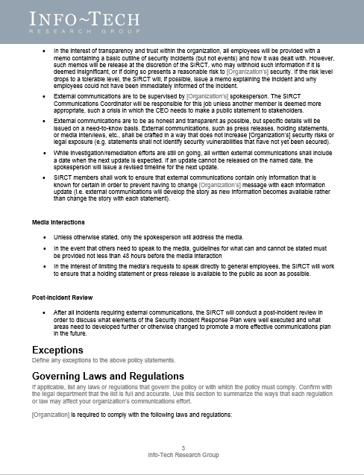
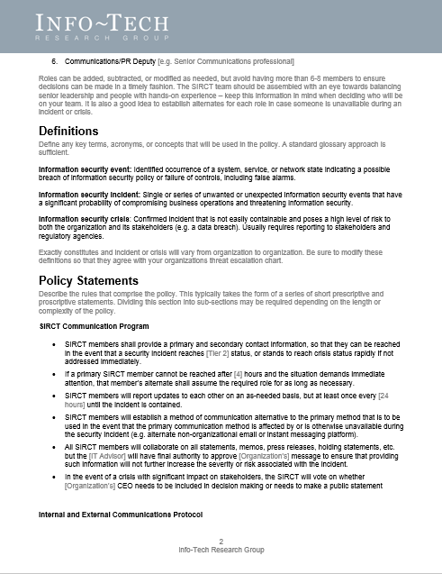
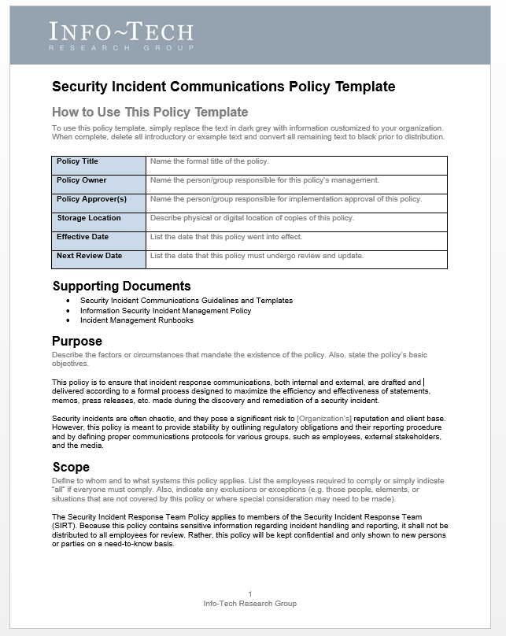
Draft the Security Incident Communications Policy Template
2.6
2.6
Security Incident Communications Policy Template
A strong communications policy outlines who is on the SIRT and defines the protocols they will need to follow, such as:
How long to wait before contacting an alternate.
Minimum frequency of updates.
What alternative communication method will be used if primary is offline.
Expectations for internal and external communications.
Customize the Security Incident Communications Policy Template to meet the needs of your organization by defining expectations and protocols for various aspects of incident response communications.
Drafting a policy helps to speed up and simplify your response process during an incident, which will help to save valuable time and offer some stability during a time of crisis. If these protocols are set in place beforehand, you’ll have to make fewer decisions during a stressful time.

Slide 16
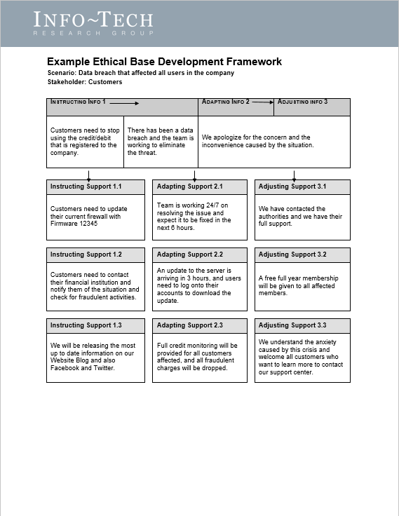
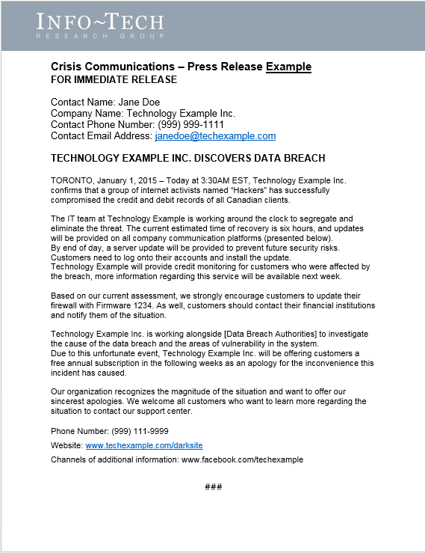
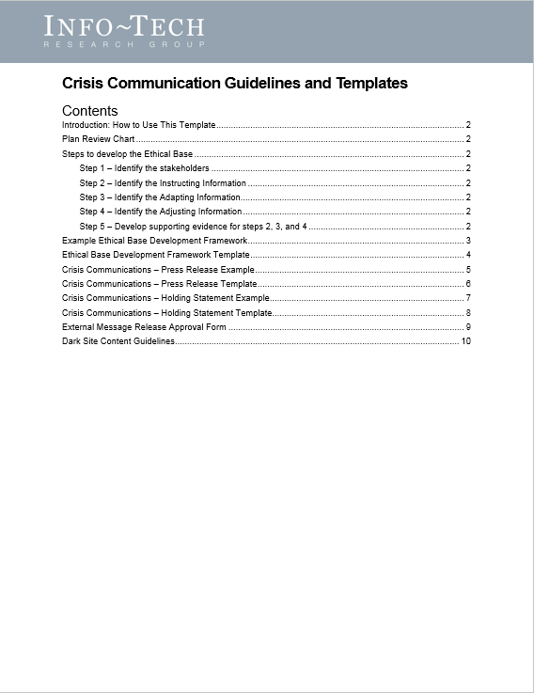

Customize the Security Incident Communications Guidelines and Templates
2.7
2.7
Security Incident Communications Guidelines and Templates
This package contains documents to help your organization with:
Outlining protocols for making effective external communications.
Drafting holding statements and press releases.
Creating an informative and useful dark site.
Implementing an external communications approval process.
The Security Incident Communications Guidelines and Templates contains both templates and examples, which will help you learn what information to include for each step of the communication sequence.
Customize these templates to suit your organization’s needs and use it as a way to begin planning your incident response communications.
Crafting holding statements, press releases, and dark sites takes time and effort. Be sure to have outlines for all of these essential communications before you need them. That way, when a crisis strikes all you’ll need to do is fill in the blanks and make small adjustments to the text.

Slide 17
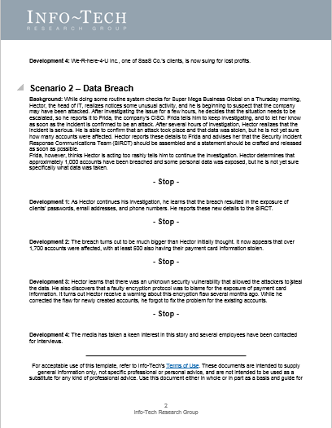
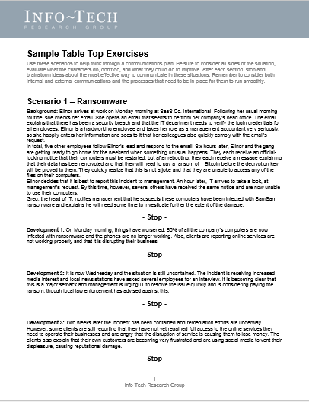
Run tabletop exercises to test the communications protocols
2.8
2.8
Tabletop Exercises Package
Foster relationships between SIRT members by letting them test the communication protocols they’ve laid out.
Tabletop exercises are one of the best ways to practice incident response. They are commonly used by IT professionals to practice working through a crisis situation from a technical standpoint. But they can also be used to streamline your communications effort.
Incident response has a lot of moving parts, so it is important to see them working in a controlled environment before needing to use them in the real world.
Doing tabletop exercises also helps to highlight gaps or oversights in your incident response communications planning. Thus, it is a good idea to run them a few times during the planning phase to make sure your plan is in good shape.
Once you have established a communications plan, it’s important to keep your team’s skills sharp. At a minimum, run a tabletop exercise once a year to make sure the SIRT is ready for the real event – especially if there are newly added members.
Try the exercises included in the Tabletop Exercises Package to get started, but don’t be afraid to create your own tabletop exercise to simulate the most likely threats for your industry.

Slide 18
Conduct a post-mortem review of the incident
2.9
Every incident offers new lessons, so make sure they don’t go to waste.
Tips for an effective post-mortem
Keep it brief – the post-mortem shouldn’t become a new source of stress. An afternoon should be more than enough time for a review.
Be supportive – chances are you won’t make it through a security crisis without a few scratches, but now is not the time lay blame or point fingers. The SIRT’s success depends on good relationships, so be sure to complement each other’s strengths.
Use constructive criticism – acknowledge where improvement could be made, but keep criticism constructive. Ultimately, every member on the team is responsible for its successes and failures.
Take notes – the point of the post-mortem is to learn, so make sure the important data is tracked so the SIRT can measure the response from one incident to the next.
Once a security incident is finally over, organizations usually want to get back to business-as-usual. However, it’s important to review the successes, mistakes, and lessons learned over the course of the incident remediation.
By holding a post-mortem review of the incident, the SIRT will have an opportunity to discuss what parts of the communications efforts worked well and what parts could be improved.
But to be effective, the post-mortem review needs to be scheduled as soon as possible after the incident or crisis has been wrapped up. This is so that SIRT members have clear memories of the events and how they handled each phase of the communications engagement.
The post-mortem review can also be a good way to boost the SIRT’s morale. Having the opportunity to discuss what members struggled with and what they did well can help them relax after the incident. This also can improve relationships between members, thereby enhancing their ability to communicate with each other.

Slide 19
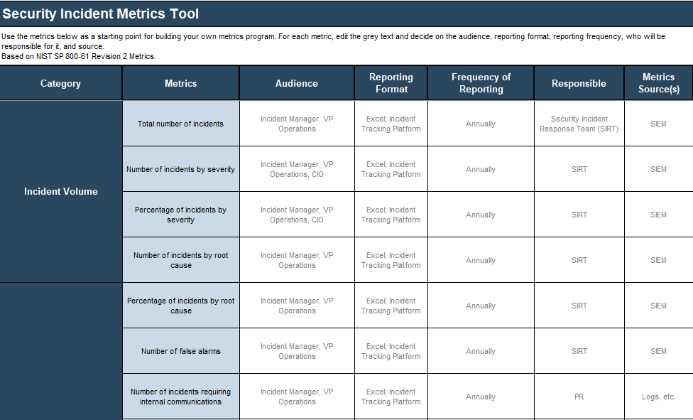
Track metrics for your incident response communications with the Security Incident Metrics Tool
2.9
Security Incident Metrics Tool
Part of your communications plan should be to track metrics related to the volume of communication types and the time spent preparing them for release.
By tracking this data, you’ll be able to see where efficiency could be improved, the costs associated with communications, and how the SIRT feels about their performance from incident to incident.
Customize this tool to reflect the metrics your organization values and who is responsible for tracking and reporting them.

Slide 20

Establish baseline metrics
Baseline metrics will improve through:
Increased communications efficiency: response time and approval processes will speed up after communications planning helps to streamline decision-making processes.
Increased awareness of the challenges associated with each incident type: effectiveness of the response will improve as the communications team becomes more familiar with what needs to be done and how to do it.
Defined threat escalation protocol: knowing who needs to be contacted and when takes a lot of the guesswork out of incident response.
Metric Description | Current Metric | Future Goal
Number of security events per year | 175 | 30
Number of security incidents per year | 61 | 20
Average time spent on communications approval (in days) | 3 | 1
Average time to issue a holding statement (in days) | 10 | 3
Average severity of fallout on social media (out of 10) | 7.5 | 3
Other metric
Other metric
Other metric
Other metric
Other metric
Other metric
Sample

Slide 21
Consider sharing information with your peers
2.10
There’s safety in numbers.
In some industries, such as finance, it’s common to share incident information with peers who are also in the industry.
The idea here is that every organization within that industry faces the same kinds of threats: if everyone shares their incident experiences, it increases the security of the industry as a whole by helping others to prepare for similar threats.
If you have contacts at other organizations within your industry, consider reaching out to them about sharing security incident data. Sometimes you can gain valuable insights into how to improve your own security culture by talking to others about theirs.
Ponemon’s 2018 “Is Your Company Ready for a Big Data Breach?” study found that:
77%
of organizations believe sharing data breach information helps to foster collaboration among peers and industry groups.
53%
suggest that sharing breach information improves security posture for their organization.
27%
argue that sharing information enhances timeliness of incident response.
24%
Claim that sharing information improves the effectiveness of their incident response plan.

